Slide 1
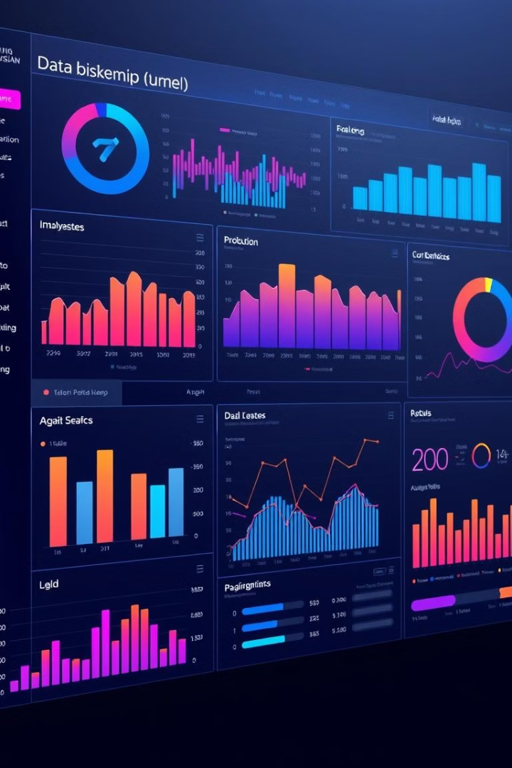
COVID-19 Dashboard Overview
Welcome to the COVID-19 Dashboard, a comprehensive resource designed to visualize and analyze global trends related to the pandemic. The dashboard leverages real-time data from various sources to provide insights into the evolving dynamics of the virus.
ss
by Rohan Pawar, Sagar Saini,
Shiwang Sanger, Vishal Nigam

Slide 2
Data Sources and Methodology
The COVID-19 Dashboard relies on data gathered from reputable sources like the World Health Organization (WHO), Johns Hopkins University Center for Systems Science and Engineering (JHU CSSEGISandData), and national health ministries.
Data Cleaning
Data Aggregation
Data Visualization
Raw data is cleaned and processed to ensure consistency and accuracy, eliminating inconsistencies and outliers.
Data is aggregated at various levels, including country, region, and global, to enable meaningful comparisons and analysis.
The dashboard employs various visualizations, such as line charts, bar graphs, and maps, to present complex data in an intuitive and understandable manner.

Slide 3
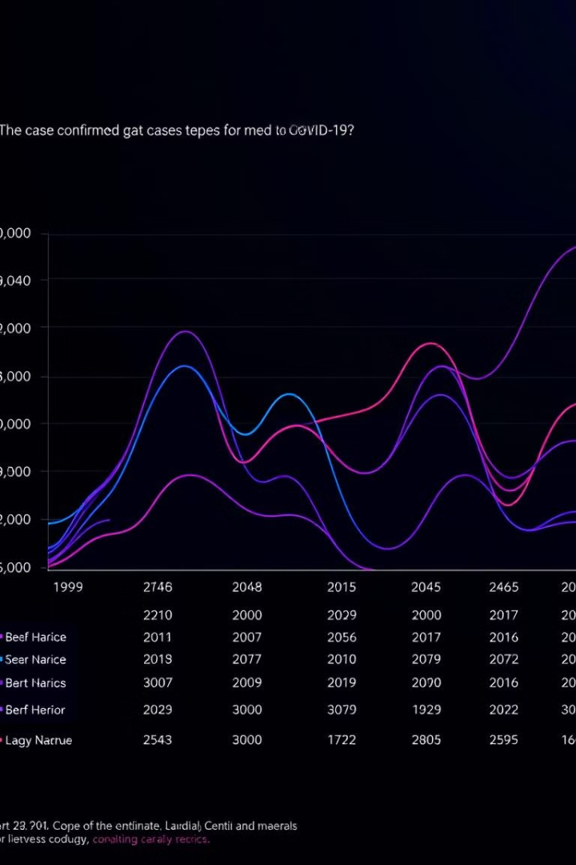
Confirmed Cases Trend
The confirmed cases trend provides a visual overview of the pandemic's spread over time. The chart reveals the rate of new infections, highlighting peak periods and potential resurgence waves.
1
Early Stages
The initial phase of the pandemic saw a rapid increase in cases as the virus spread globally.
2
Peak Periods
Certain periods witnessed sharp peaks in confirmed cases, indicating significant surges in transmission.
3
Resurgence Waves
The pandemic has shown patterns of resurgence, with new waves of infections emerging at intervals.

Slide 4
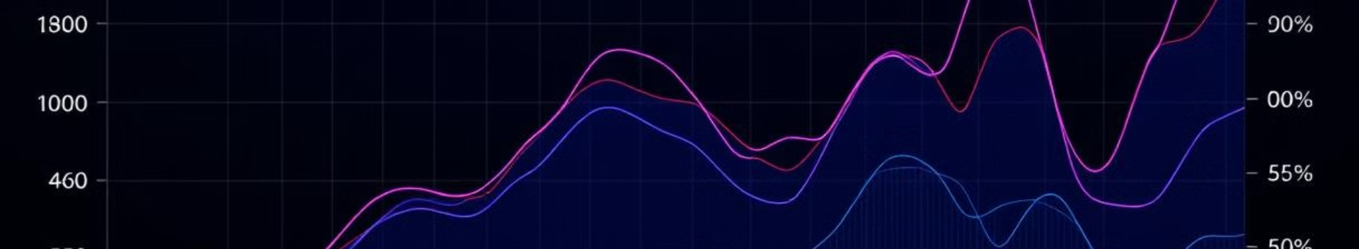
Total Deaths Trend
The total deaths trend provides a somber illustration of the pandemic's impact, highlighting the cumulative number of lives lost due to the virus.
1
Peak Periods
2
Regional Variations
3
Trend Analysis
Certain time periods have witnessed a sharp increase in the number of deaths, indicating periods of higher fatality rates.
Different countries and regions have experienced varying levels of mortality, influenced by factors like population density and access to healthcare.
Tracking the trend of total deaths helps understand the pandemic's impact and the effectiveness of various mitigation strategies.

Slide 5
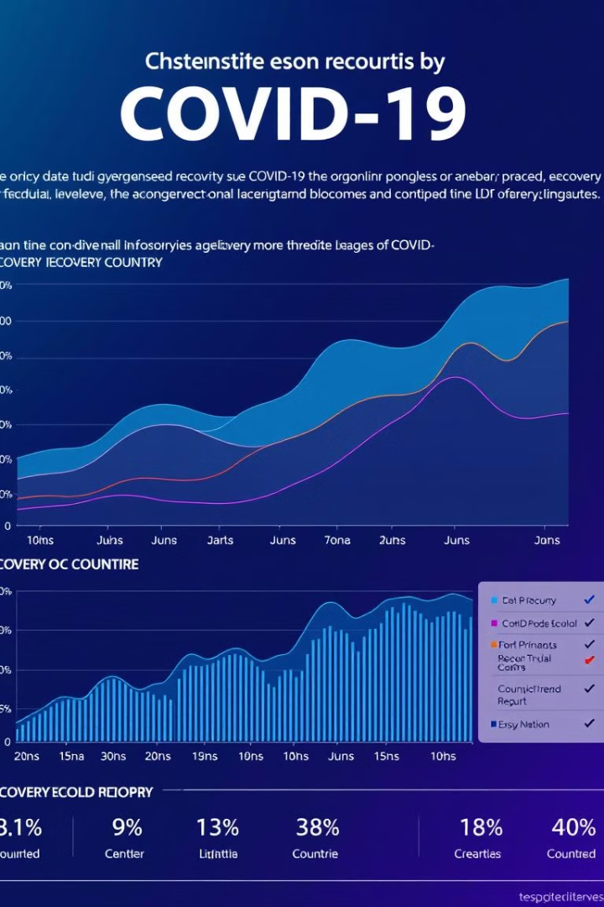
Recovery Cases Trend
The recovery cases trend offers a positive perspective, showcasing the number of individuals who have successfully recovered from the virus. The chart indicates the effectiveness of treatment and the overall resilience of the population.
Country
Recovery Rate (%)
United States
98.9
United Kingdom
99.3
India
98.5
China
99.8

Slide 6
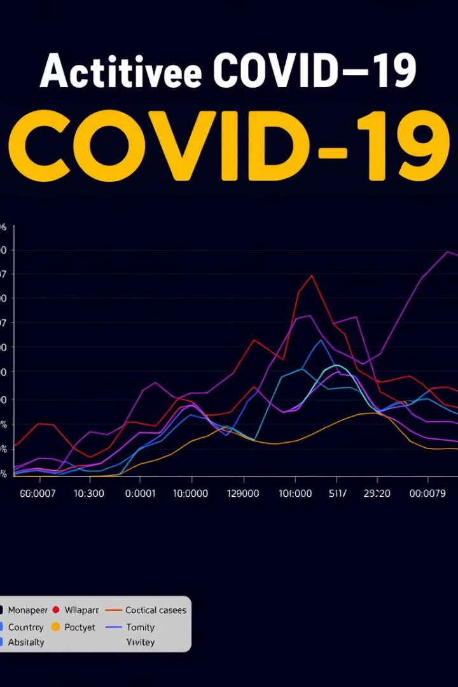



Active Cases Trend
The active cases trend provides a real-time snapshot of the pandemic's ongoing spread, showcasing the number of individuals currently infected with the virus. It reveals the extent of the virus's active circulation in various regions.
Peak Periods
Periods with a high number of active cases indicate widespread transmission.
Decline Phases
A downward trend in active cases suggests a decline in transmission.
Mitigation Strategies
Public health interventions, like lockdowns and vaccination campaigns, have a significant impact on the number of active cases.

Slide 7
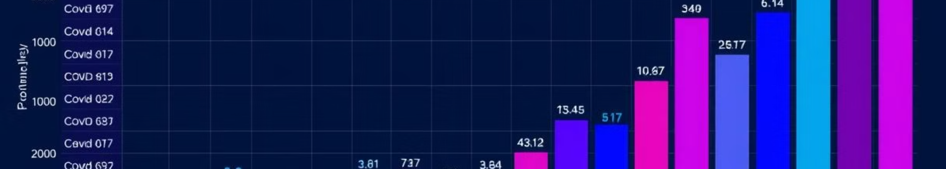
Case Fatality Rate
The case fatality rate (CFR) represents the proportion of confirmed cases that result in death. It's a key indicator for understanding the severity of the pandemic and the effectiveness of medical care.
Factors Influencing CFR
Mitigation Strategies
Trend Analysis
The CFR can vary based on factors like age, underlying health conditions, access to healthcare, and the strain of the virus.
Public health interventions, like lockdowns and vaccinations, have a positive impact on reducing the CFR.
Monitoring the CFR over time provides insights into the pandemic's evolution and the effectiveness of medical advancements.

Slide 8
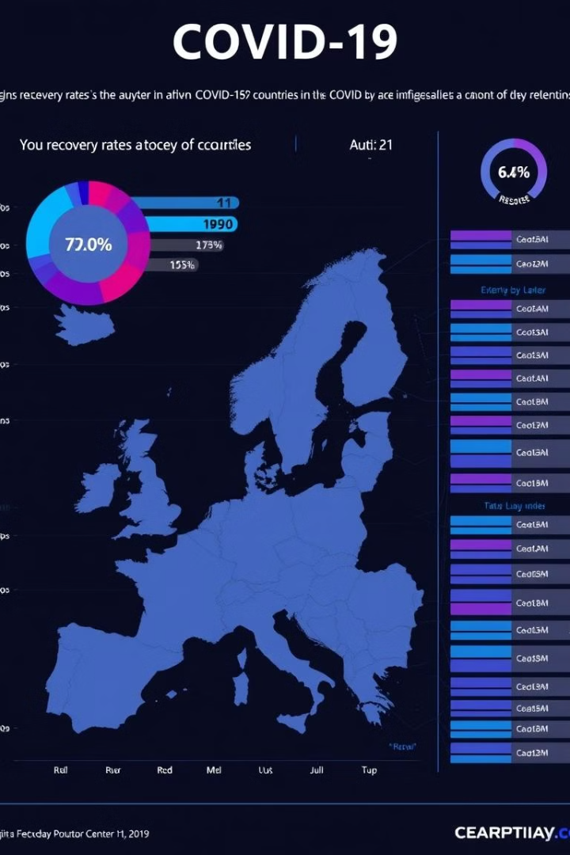



Recovery Rate
The recovery rate indicates the percentage of confirmed cases that have successfully recovered from the virus. It's an essential indicator for understanding the pandemic's long-term impact and the effectiveness of medical care.
Recovery Rate Trend
The recovery rate has been steadily increasing in most countries, indicating improved medical treatment and public health measures.
Factors Influencing Recovery
Factors like access to healthcare, age, and underlying health conditions can influence recovery rates.
Vaccination Impact
Vaccination campaigns have significantly contributed to improving recovery rates by reducing the severity of infection.

Slide 9
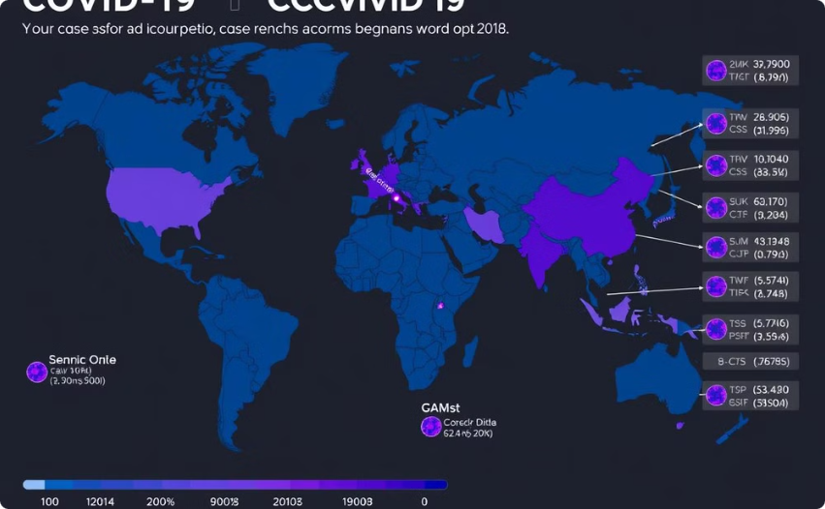
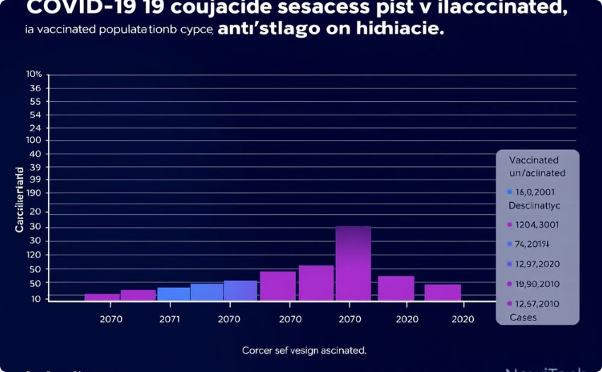
Insights and Observations
Analyzing the data reveals key insights about the pandemic's progression, the effectiveness of various mitigation strategies, and the overall impact on different populations.
Regional Variations
Vaccination Impact
The pandemic has affected different regions of the world differently, influenced by factors like population density and access to healthcare.
Vaccination campaigns have significantly reduced the number of cases, hospitalizations, and deaths, highlighting the importance of vaccination.

Slide 10

Conclusion and Key Takeaways
The COVID-19 Dashboard serves as a valuable tool for understanding the pandemic's dynamics, tracking the effectiveness of mitigation strategies, and informing public health policies.
1
Data-Driven Insights
2
Mitigation Strategies
The dashboard leverages real-time data to provide insights into the pandemic's evolving trends.
The data reveals the effectiveness of various mitigation strategies, such as lockdowns, masks, and vaccinations.
3
Public Health Impact
The dashboard highlights the pandemic's impact on public health, revealing the need for ongoing research and policy adjustments.

